Slide 1
JAVA Lecture 2
Classes, Objects and Methods

Slide 2
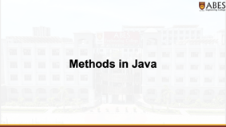
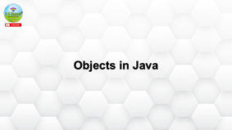

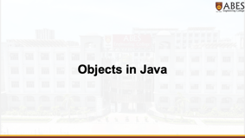



Slide 3
Classes in Java

Slide 4
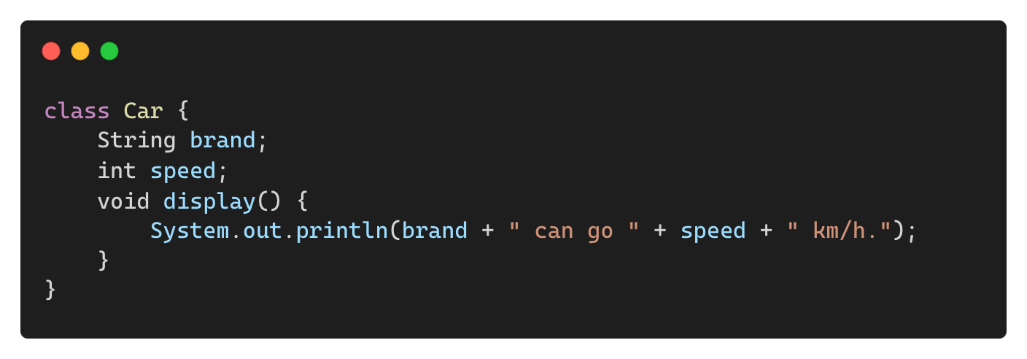
What is a Class?
Definition:
A class is a blueprint for creating objects.
It defines attributes (variables) and behaviors (methods).
Objects are instances of a class.
Example:

Slide 5
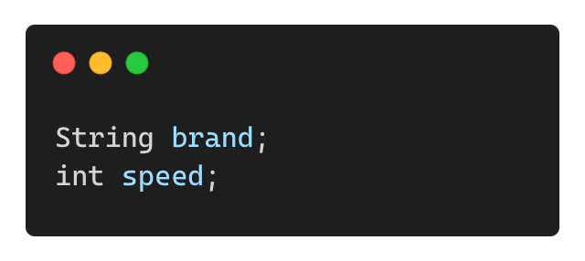
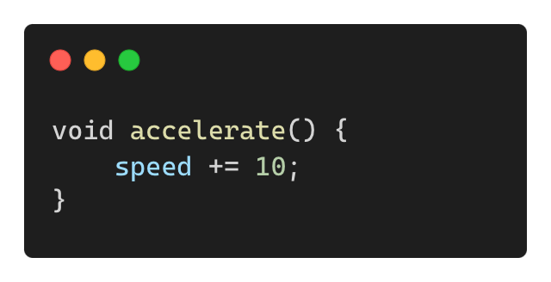
Key Components of a Class
Fields (Instance Variables): Store data of objects.
Methods: Define object behaviours.
Constructors: Initialize objects when they are created.
Objects: Instances of a class with real data.

Slide 6
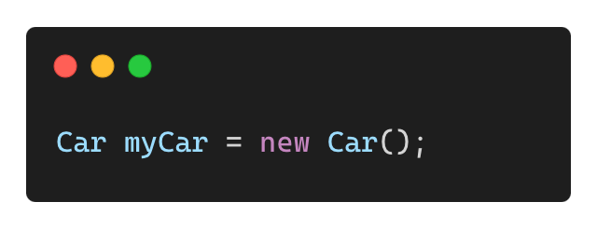
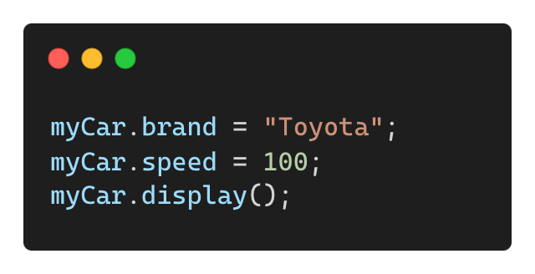
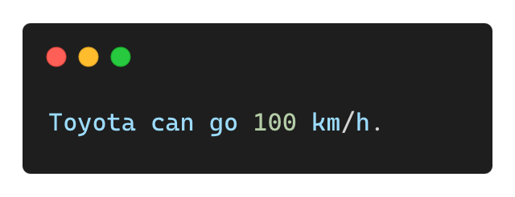
Creating and Using Objects
Creating an Object:
Assigning Values and Calling Methods:
Output:

Slide 7
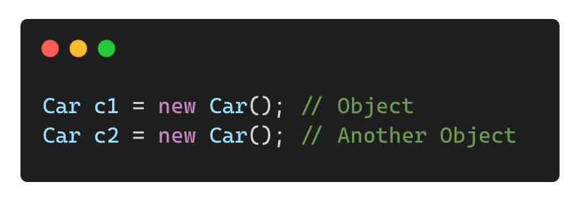
Class vs. Object
Feature | Class | Object
Definition | Blueprint / template | Instance of a class
Memory | No memory allocated | Memory allocated when created
Example | Car class | myCar object

Slide 8
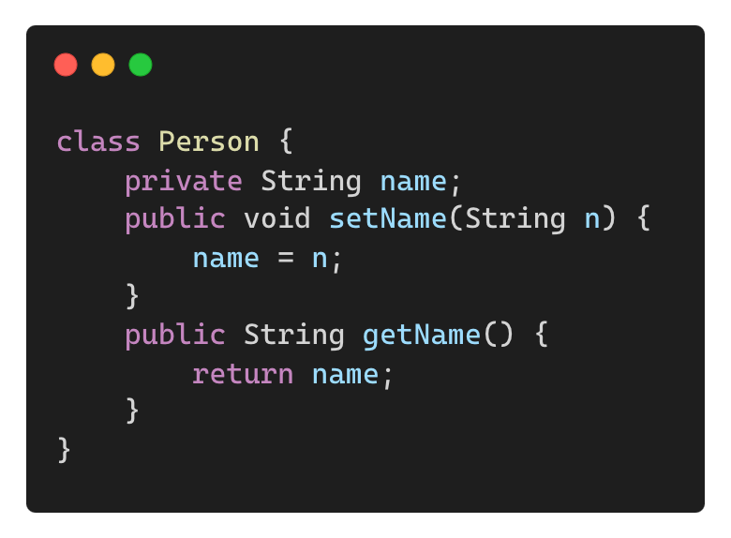
Access Modifiers in a Class
Control the visibility of variables and methods:
public: Accessible from anywhere.
private: Accessible only within the class.
protected: Accessible within the same package and subclasses.

Slide 9
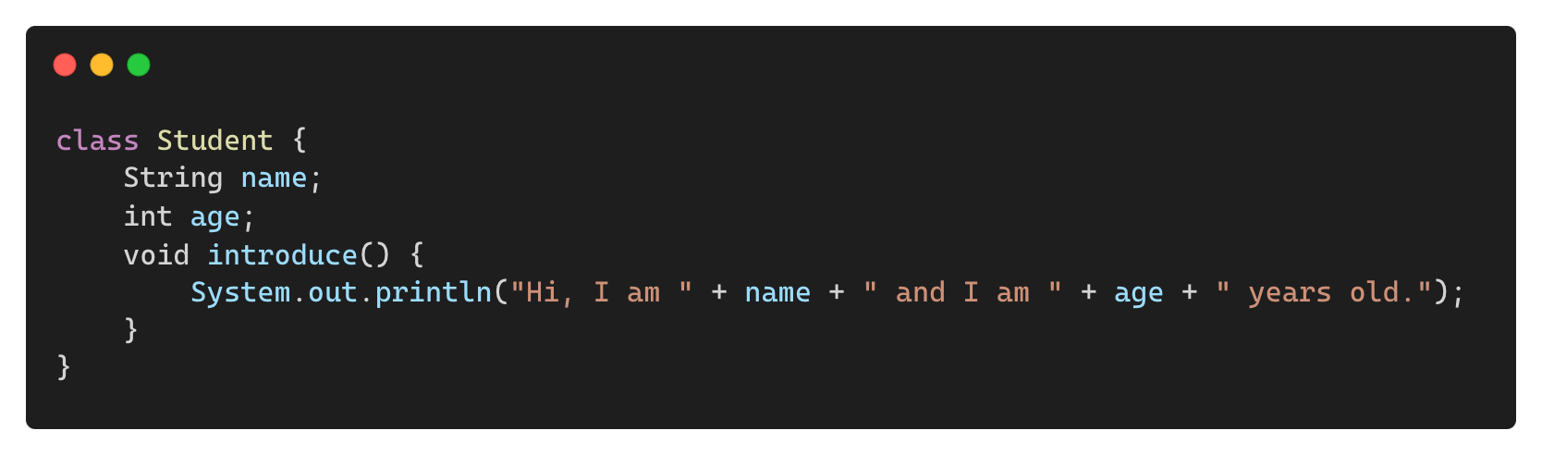
Real-World Example of a Class
Example: Defining a Student Class

Slide 10
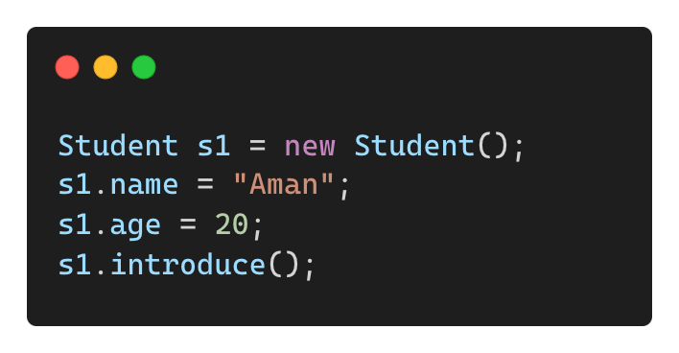
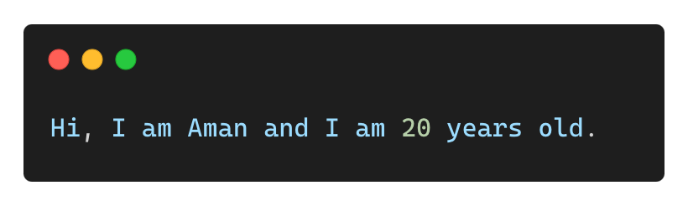
Real-World Example of a Class
Creating and Using Objects
Output:

Slide 11
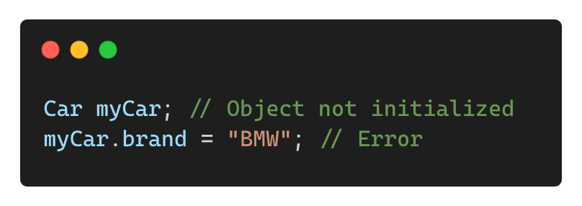
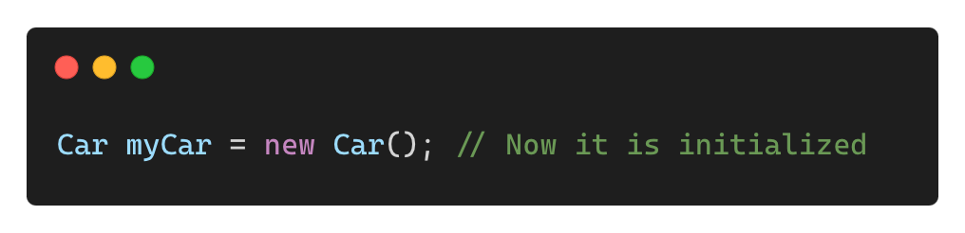
Common Mistakes with Classes
❌ Forgetting to Initialize Objects
✅ Correct Way

Slide 12
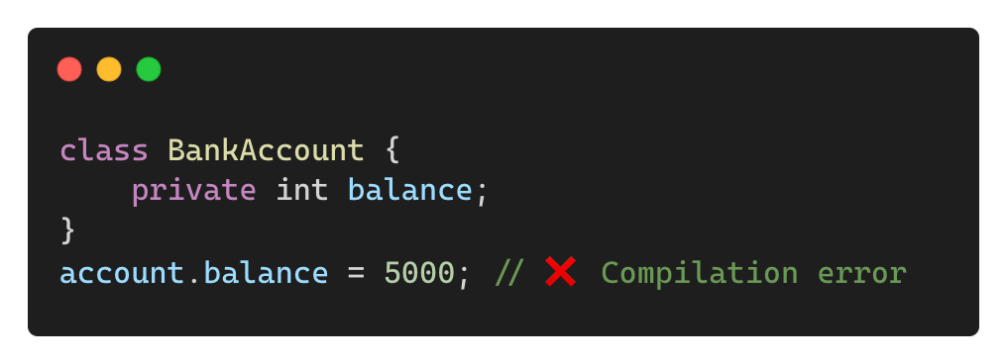
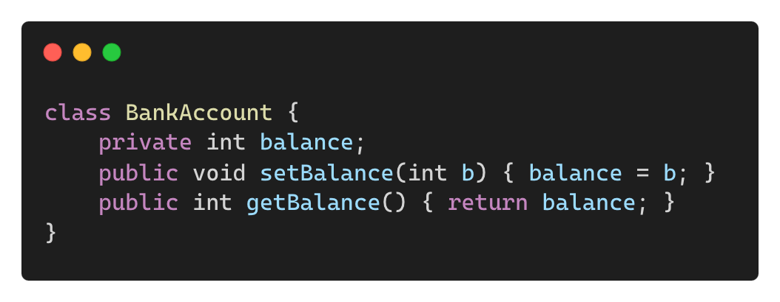
Common Mistakes with Classes
❌ Using private Variables Without Getters/Setters:
✅ Solution:

Slide 13
Objects in Java

Slide 14
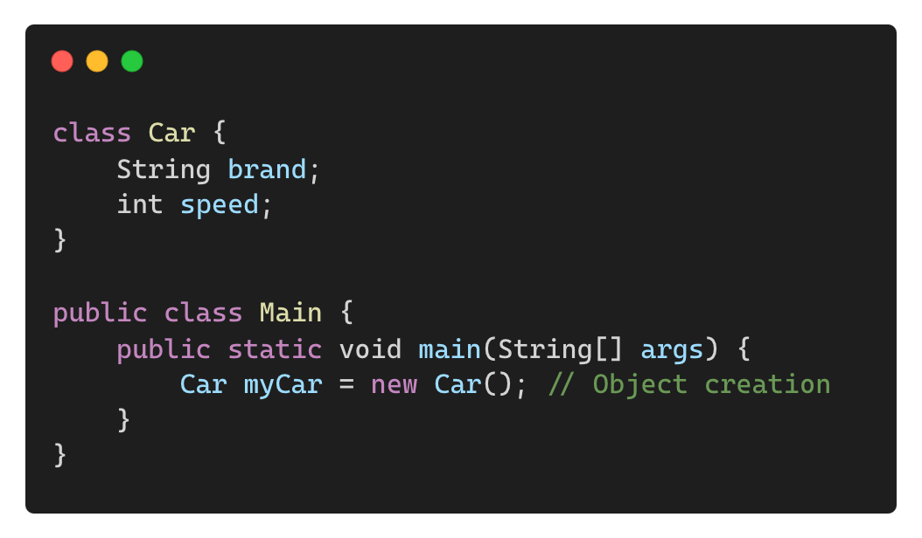
What is an Object?
An object is an instance of a class containing state (variables) and behavior (methods).
Objects are created using the new keyword.
Example:

Slide 15
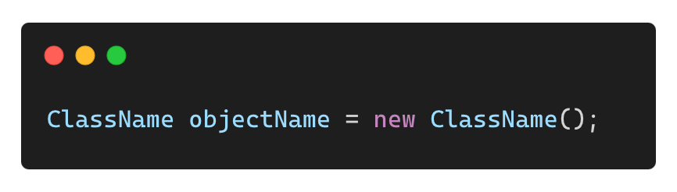
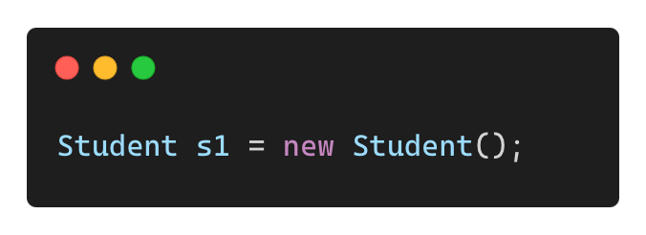
Declaring an Object in Java
Syntax:
Example:
Breaking it Down:
• Student → Class name
• s1 → Reference variable
• new Student() → Creates an object in memory

Slide 16
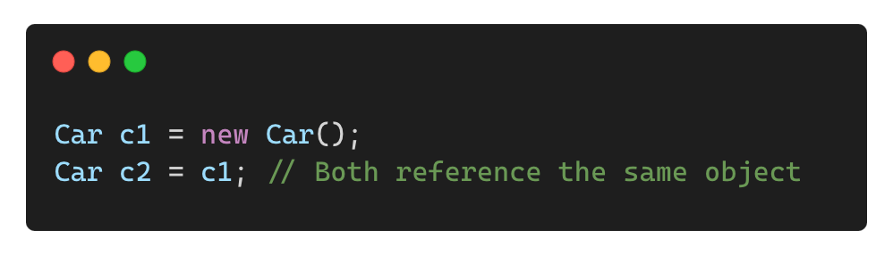
Reference Variables vs. Objects
Feature | Reference Variable | Object
Definition | Stores memory address of an object | Actual instance of a class
Created in | Stack Memory | Heap Memory
Example | Car myCar; | new Car();
Access | Methods & properties via reference | Exists independently

Slide 17
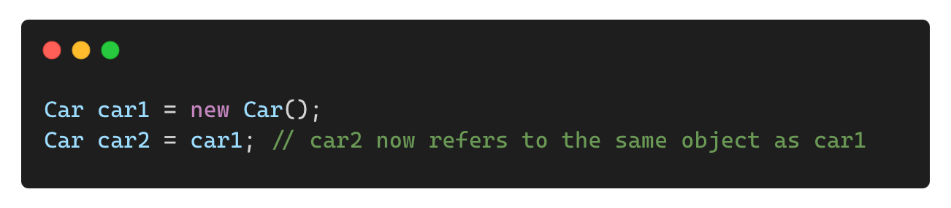
Multiple Reference Variables for One Object
Two or more variables can refer to the same object:
Memory Representation:
car1 and car2 both point to the same object in heap memory.

Slide 18
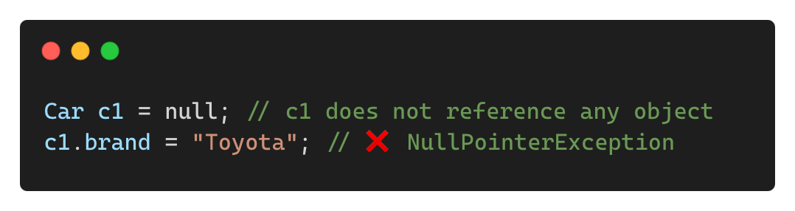
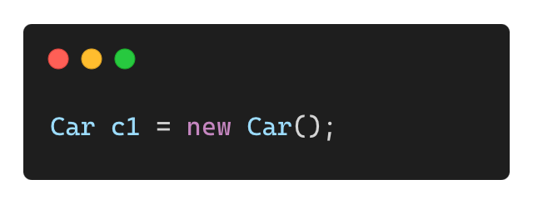
What Happens When Reference is Null?
A reference variable can be null, meaning it points to no object.
Example:
Solution:
Always initialize an object before accessing its properties

Slide 19
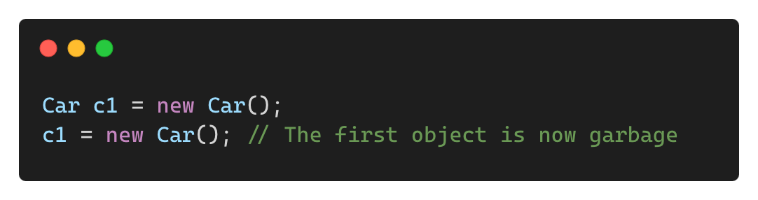
Garbage Collection and Unused Objects
If an object has no reference variables pointing to it, it becomes eligible for garbage collection.
Example:
Memory Management in Java:
Garbage Collector (GC) automatically removes unused objects to free memory.

Slide 20
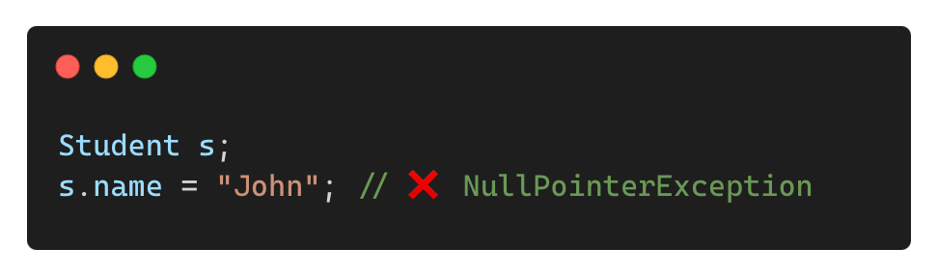
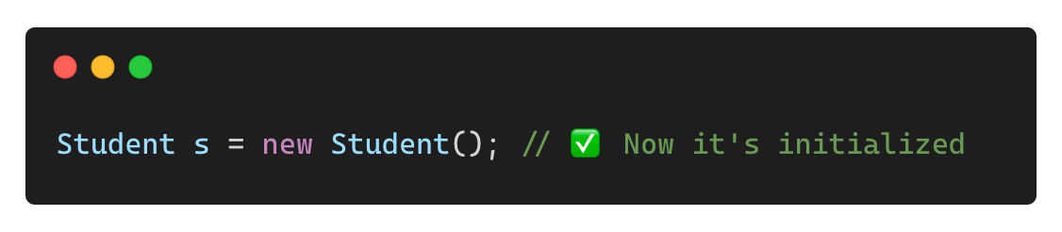
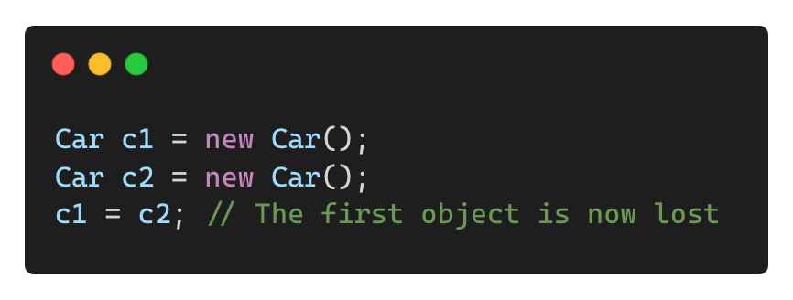
Common Mistakes with Object References
❌ Using an Uninitialized Object Reference
✅ Solution:
❌ Overwriting References Unintentionally
✅ Solution: Track object references carefully.

Slide 21
Methods in Java

Slide 22
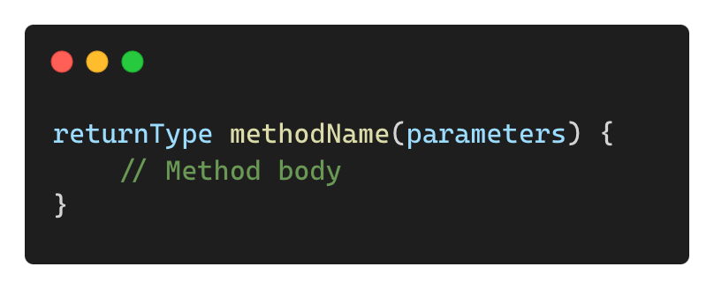
What is a Method?
A method is a block of code that performs a specific task.
It helps in code reusability and modularization.

Slide 23
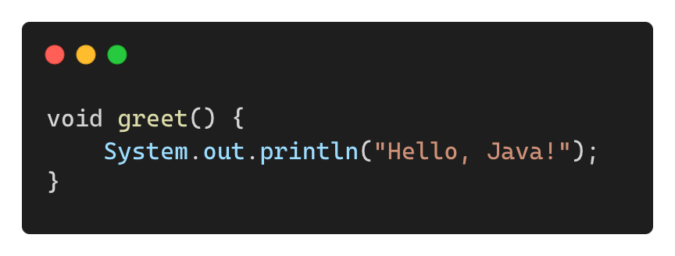
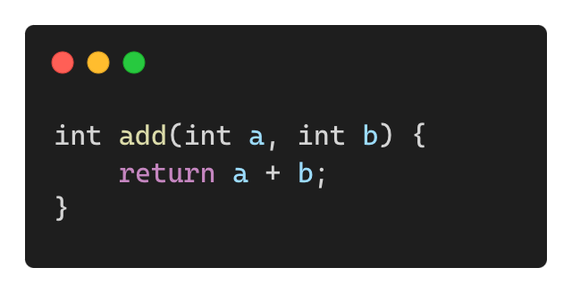
Types of Methods
Void Methods (Do not return a value)
Methods Returning a Value

Slide 24
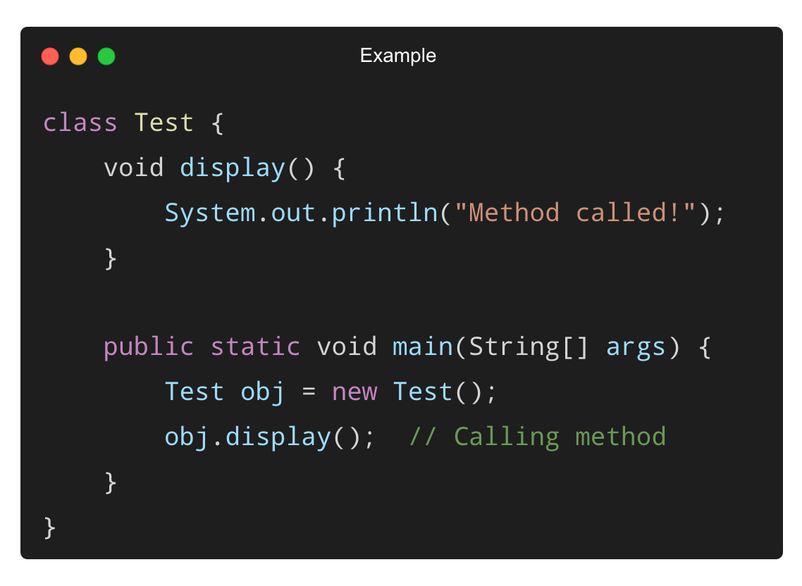
Calling a Method
A method must be called to execute.
Example:
Output:
Method called!

Slide 25
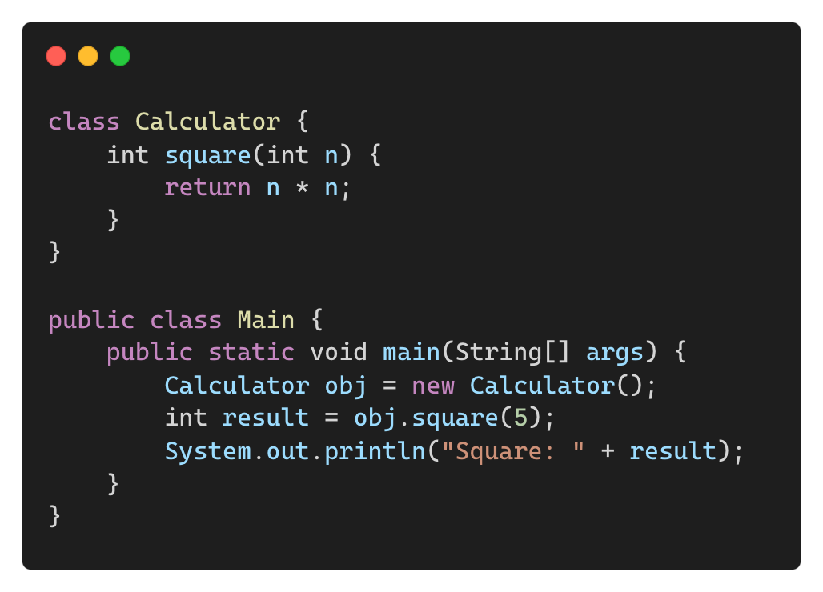
Returning a Value from a Method
Example of a method that returns a value:
Output:
Square: 25

Slide 26
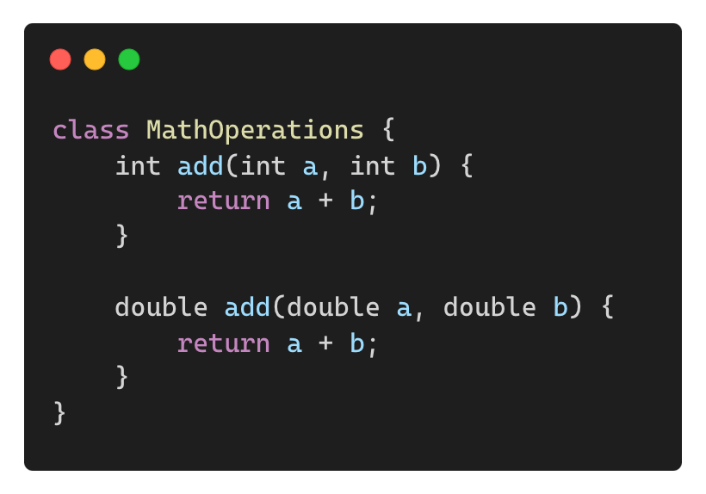
Method Overloading (Multiple Methods with Same Name)
Two or more methods with the same name but different parameters.
Example:
Why use overloading?
✅ Improves code readability
✅ Provides flexibility in method usage

Slide 27
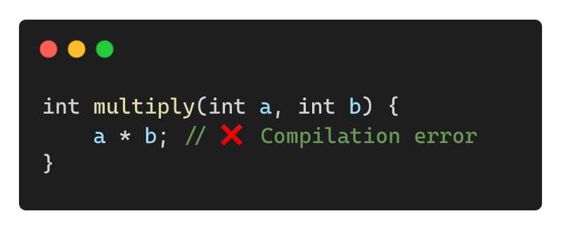
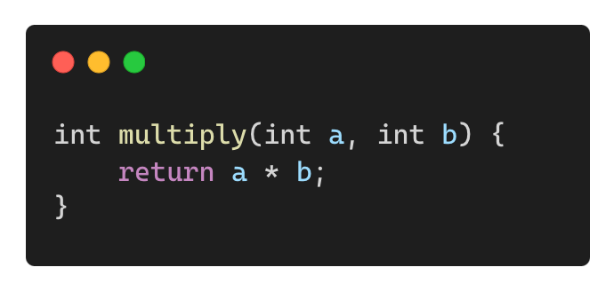
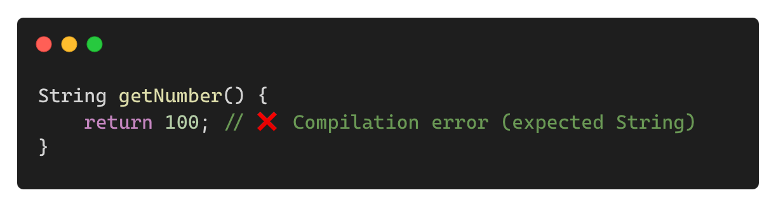
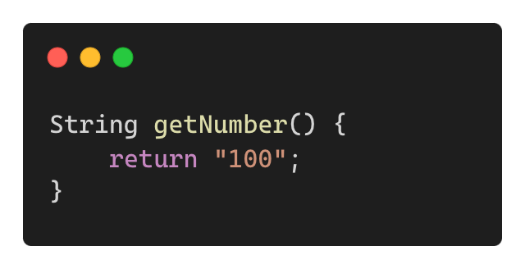
Common Mistakes in Method Definitions
❌ Missing Return Statement in Non-void Methods
✅ Correct:
❌ Mismatched Return Type
✅ Correct:

Slide 28
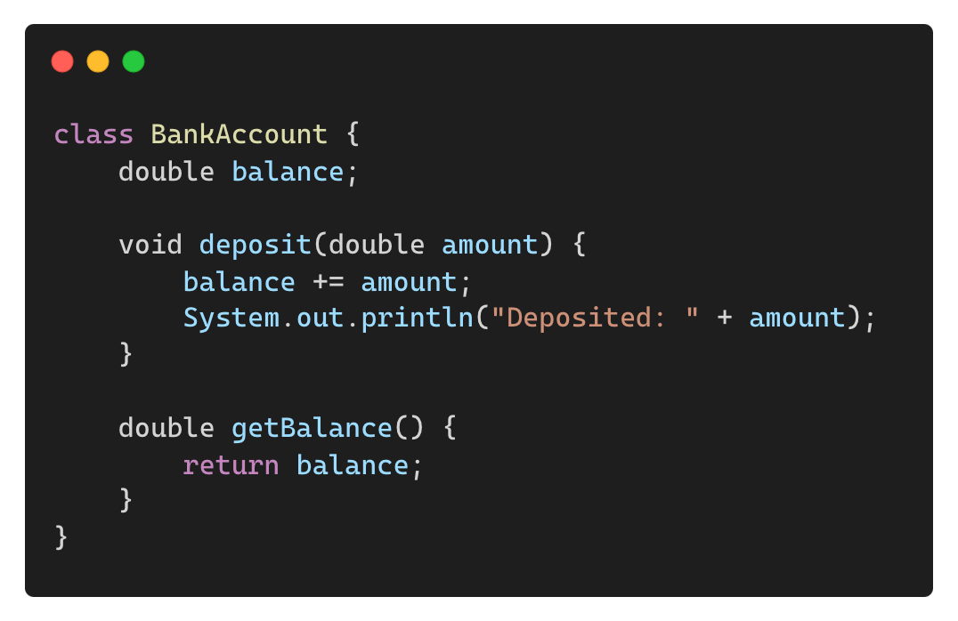
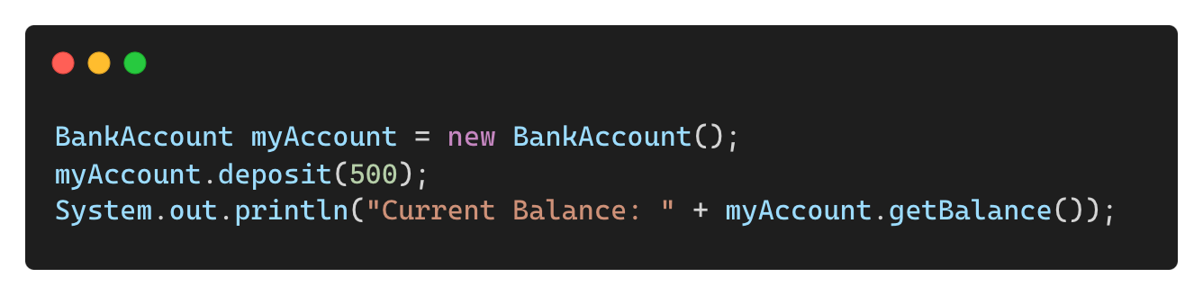
Real-world Example – A Simple Banking System
Example of method usage in a class:
Executing Methods:
Output:
Deposited: 500
Current Balance: 500

Slide 29
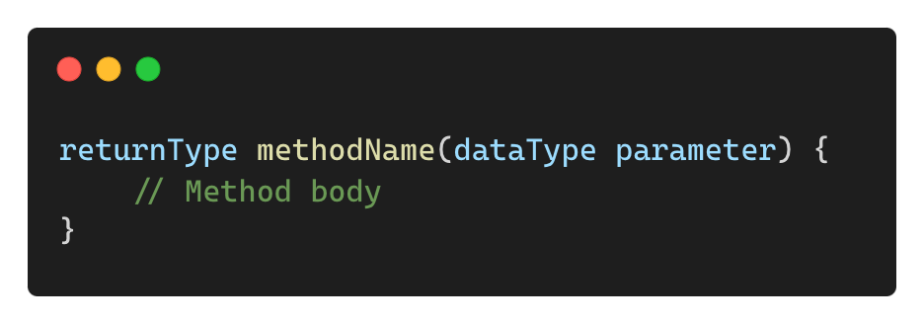
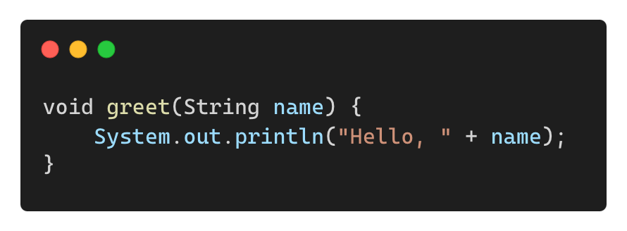
What are Parameters in Methods?
Parameters act as input values that are passed to methods.
They allow dynamic data processing rather than using fixed values.
Syntax:
Example:

Slide 30
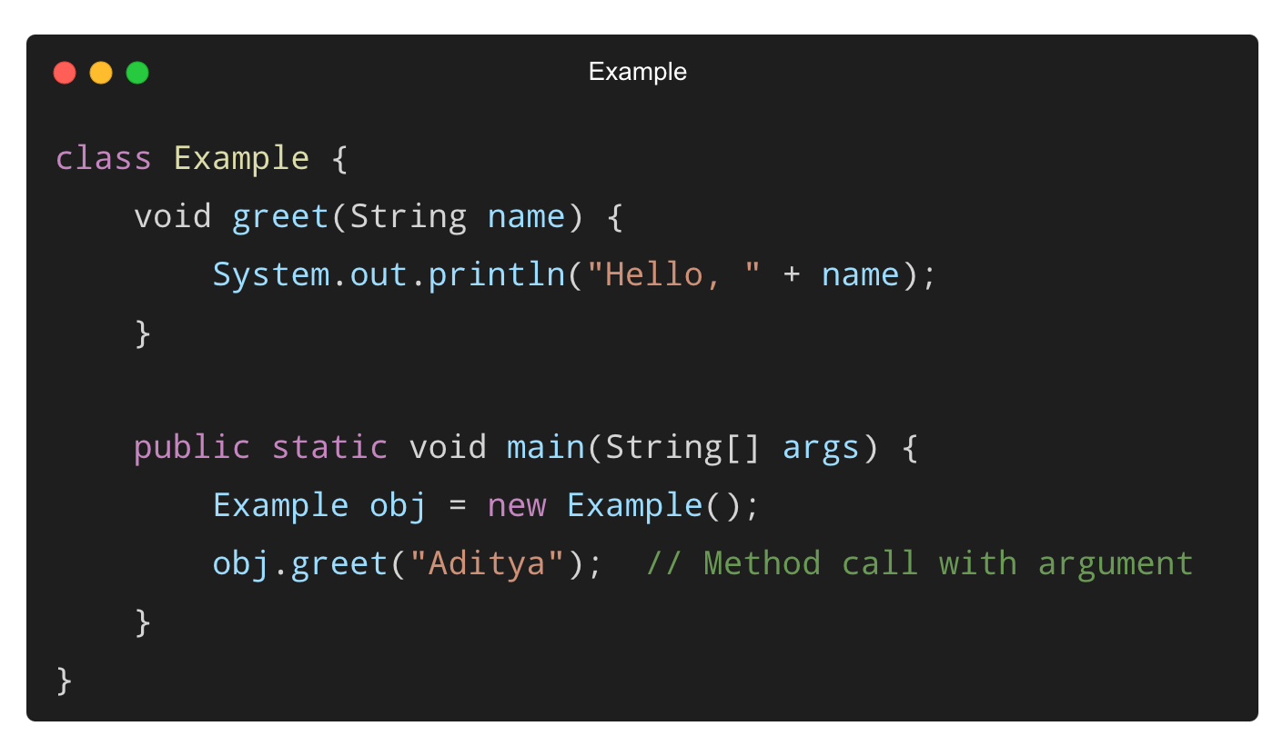
Calling a Method with Parameters
Output:
Hello, Aditya

Slide 31
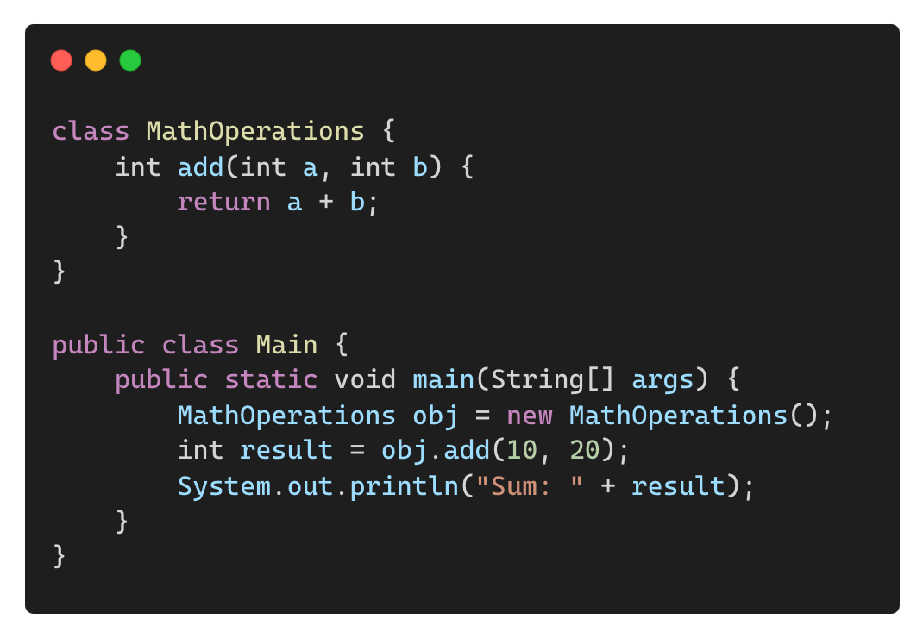
Methods with Multiple Parameters
Output:
Sum: 30

Slide 32
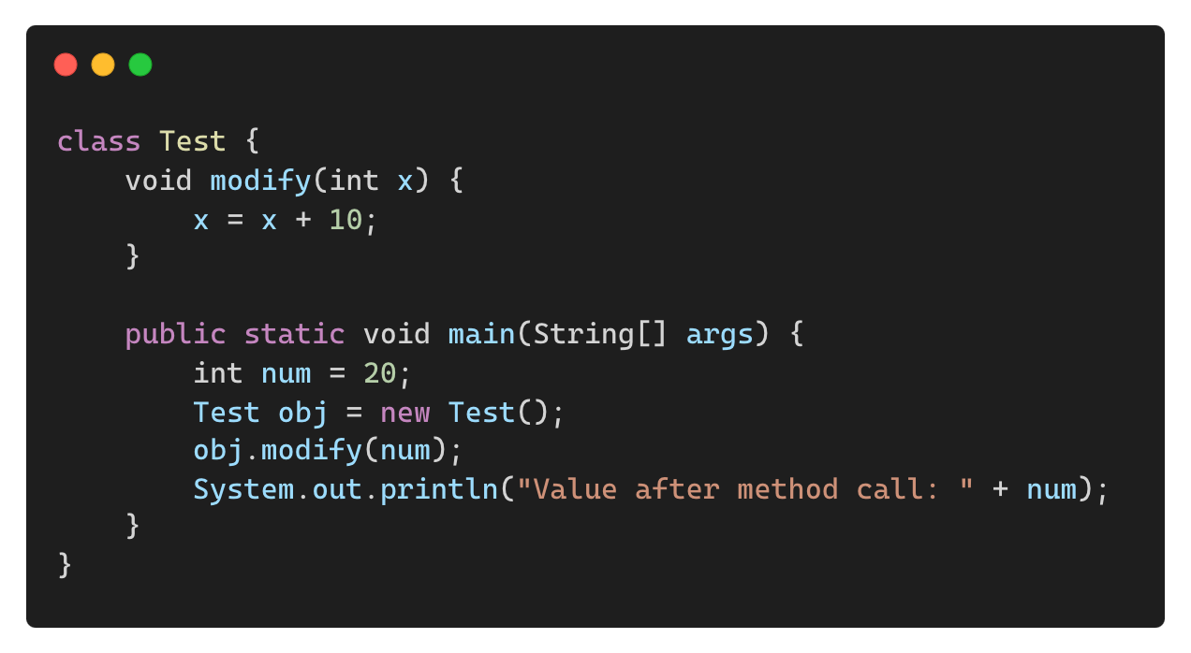
Pass-by-Value in Java (Primitive Types)
In Java, all primitive types are passed by value (a copy is made).
Output:
Value after method call: 20
Why? The original value remains unchanged because a copy was passed.

Slide 33
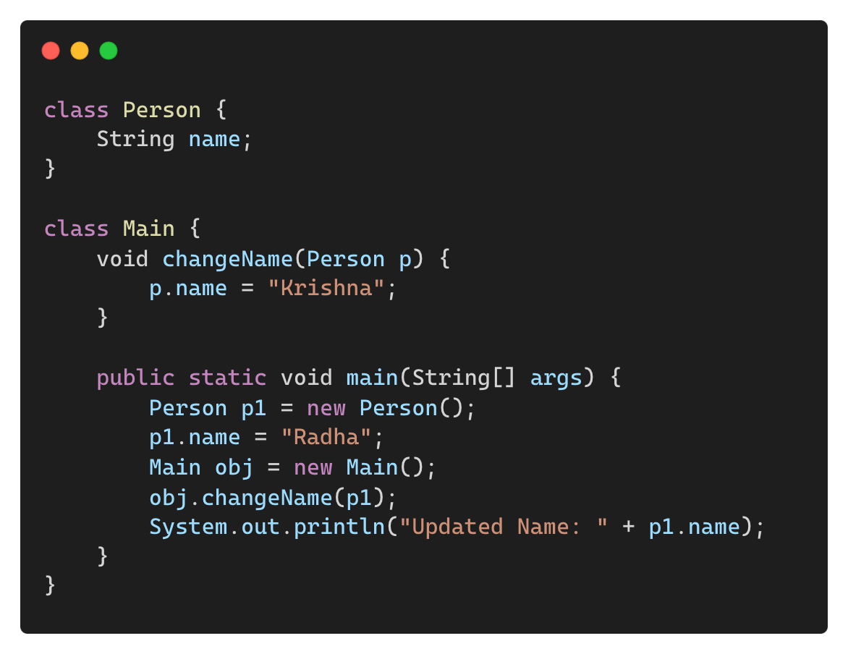
Passing Objects as Parameters (Pass-by-Reference Effect)
Objects behave differently – they are passed as references.
Output: Updated Name: Krishna
Why? Objects share memory reference, so changes persist.

Slide 34
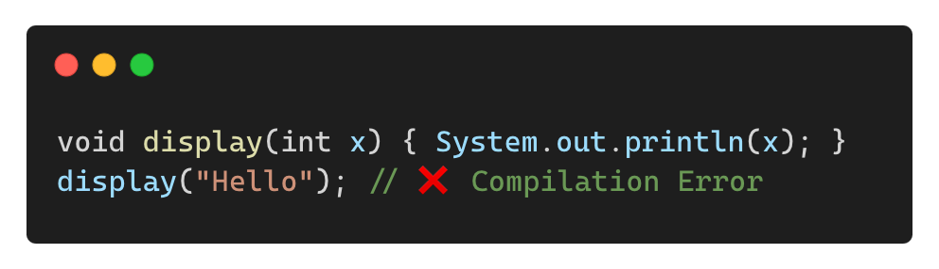
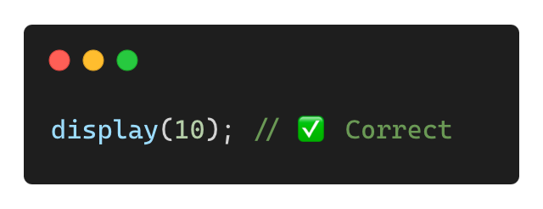
Common Mistakes with Parameters
❌ Mismatched Argument and Parameter Types
✅ Solution: Ensure correct data types:

Slide 35
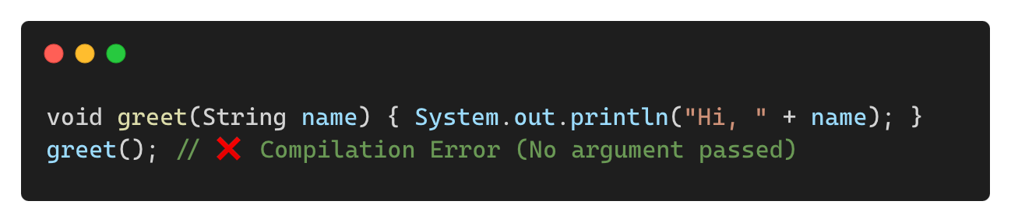

Common Mistakes with Parameters (Contd.)
❌ Forgetting to Pass Required Parameters
✅ Solution: Provide arguments when calling methods:

Slide 36
THANK YOU

